Slide 1


WebDriver. WebDriver JS. Protractor.
Locators.

Slide 2
AGENDA
1
Selenium Webdriver Overview.
2
WebDriver. How it works?
3
WebDriverJS API.
4
Locators.

Slide 3
PART 1
Selenium Webdriver
overview

Slide 4




SELENIUM – is a set of different software tools each with a different approach to supporting test automation.
SELENIUM IDE
SELENIUM WEBDRIVER
SELENIUM RC
SELENIUM SERVER + GRID
Firefox add-on that does simple record-and-playback of interactions with the browser.
A collection of language specific bindings to drive a browser.
The previous version of the library for browser management (deprecated)
Selenium Server lets you control the browser from a remote machine over the network.
Selenium Grid – cluster consisting of several Selenium Servers.

Slide 5
SELENIUM FUTURE – 3.0
Selenium 3.0 – was released in 2016.
https://seleniumhq.wordpress.com/2016/10/13/selenium-3-0-out-now/
https://www.joecolantonio.com/2016/05/31/selenium-3-sneak-peak/
https://github.com/SeleniumHQ/selenium/wiki/Shipping-Selenium-3

Slide 6
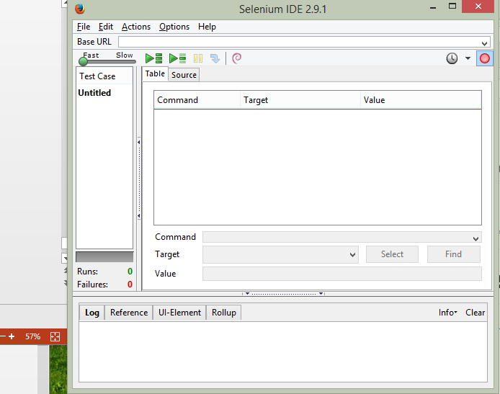
SELENIUM IDE
Selenium IDE – Mozilla Firefox extension
http://www.seleniumhq.org/download/
Capabilities:
record and playback simple tests
simple assertions
export generated code
Usually is used for
Selenium automation get stared
Create a small scenario for quick bug replication
Auxiliary script to avoid routine during manual testing
Doesn’t require any programming skills
Has a lot of plugins, that may significantly extend Selenium IDE capabilities

Slide 7
SELENIUM WEBDRIVER VS. SELENIUM RC
SIMILARITY:
Allow you to use a programming language in designing your test scripts.
Allow you to run your tests against different browsers.
Architecture
Speed
Real-life Interaction
API
DIFFERENCE:
Notes:
http://www.guru99.com/introduction-webdriver-comparison-selenium-rc.html

Slide 8
SELENIUM WEBDRIVER ARCHITECTURE
Bindings
Drivers
Language level bindings
Selenium Webdriver API
Drivers
C#
IE
Java
Chrome
JS
Selenium Webdriver
API
Firefox
Python
Opera
Others
Others

Slide 9
SELENIUM WEBDRIVER WORKFLOW
An automation developer creates a scenario in any high level language (using a corresponding library)
The scenario is accepted by WebDriver and transformed into the language, that a particular browser (depends on WebDriver type) understands
Browser performs the manipulations, that were described in the first step
Workflow of Selenium Webdriver
Test Scripts
Webdriver
Browsers

Slide 10

SUPPORTED BROWSERS
1
Firefox
2
IE (7-11)
3
Edge (not all major features are yet implemented)
4
Safari (5.1+)
5
Opera
6
Chrome

Slide 11




SUPPORTED PLATFORMS
1
Windows
2
Linux
3
Mac OS
4
OS X
5
Solaris
6
Android
7
iOS

Slide 12
WHAT IS WEBDRIVER? PROS AND CONS
Pros | Cons
Selenium is pure open source, freeware and portable | Require expertise resources, well versed in frameworks
Supports a lot of languages (Java, C#, …) | Difficult to test image based applications
Supports many OS-s and browsers | Needs outside support for report generation
Can be integrated with build tools | Does not support built in add-ins support
Can be integrated into testing frameworks | Does not provide any built in IDE
Can be integrated with Jenkins and other CI tools | Does not support file upload facility
Low CPU and RAM consumption | Script creation time is bit high
Faster test execution (in comparison with Selenium RC) | Partially supports for Dialog boxes
Doesn’t require Selenium Server (unlike Selenium RC)

Slide 13
PART 2
WebDriver.
How it works?

Slide 14
WEBDRIVER. LAYERS
WebDriver API
WebDriver SPI
JSON
Browser

Slide 15
WEBDRIVER. FROM TEST TO BROWSER
Webdriver driver = new FirefoxDriver(); WebElement input = driver.findElement(By.name("q")); input.sendKeys("webdriver"); input.getAttribute("value");
API Object oriented
SPI Procedural
newSession(browser: 'firefox') findElement(using: 'name', value: 'q') sendKeysToElement(id: '00cbe31e', value: '[webdriver]') getElementAttribute(id: '00cbe31e', name: 'value')
SPI
JSON
command -> { command: "sendKeys", parameteres: { element: <opaque element identifier>, value: ["webdriver"] } } response <- {status: 0}

Slide 16
WEBDRIVER. WIRE PROTOCOL
client
server
Language Binding
Browser
JAVA
Ruby
C#
JS
Python
JSON
HTTP
Firefox
Chrome
IE
Opera
Maps SPI commands to RESTish HTTP resources
newSession(browser: 'firefox') findElement(sessionId: 'c688f8e4', using: 'name', value: 'q') sendKeysToElement(id: '00cbe31e', value: '[webdriver]') getElementAttribute(id: '00cbe31e', name: 'value')
POST/session POST/session/c688f8e4/element/ POST/session/c688f8e4/element/00cbe31e/value GET/session/c688f8e4/element/00cbe31e/attribute/value

Slide 17

WEBDRIVER JS
WebdriverJS is full value wrapper over JSON Wire Protocol, it provides high level interface to control different browsers. It is JavaScript API of the popular tool Webdriver. It based on Node JS platform and can be installed as npm package.

Slide 18


WEBDRIVER JS
WebDriver JavaScript API is entirely asynchronous and every command results in a promise.
Synchronous
Asynchronous

Slide 19
WEBDRIVER JS. ASYNCRONOUS CODE
Synchronous
quickCall(); timeConsumingCall(); iHaveToWait(); WAITS for timeConsumingCall() to complete
Asynchronous
quickCall(); timeConsumingCall(); iWontWait(); DOES NOT WAIT for timeConsumingCall() to complete
Notes:
S

Slide 20
WEBDRIVER JS. ASYNCHRONOUS JAVASCRIPT
console.log("start"); fs.readFile('/etc/passwd', (err, data) => {
if (err) throw err;
console.log("done");
});
console.log("end");
Stack
webapis/IO
cb
console.log("end")
console.log("done")
fs.readFile(cb)
console.log("start")
console
main()
start
event loop
end
done
cb
task queue

Slide 21
PART 4
WEBDRIVERJS API

Slide 22
WEBDRIVERJS API. CLASS WEBDRIVER
Each WebDriver instance provides automated control over a browser session.
Method | Description | Example
close() | Schedules a command to close the current window. | driver.close();
quit() | Terminates the browser session. | driver.quit();
findElement(locator ) | Schedule a command to find an element on the page. | var el = driver.findElement(By.id('foo'));
findElements(locator) | Schedule a command to search for multiple elements on the page. | var els = driver.findElements(By.className('foo'));
get(url) | Schedules a command to navigate to the given URL. | driver.get('http://www.google.com/');
getCurrentUrl() | Schedules a command to retrieve the URL of the current page. | driver.getCurrentUrl();
wait( condition, opt_timeout, opt_message ) | Schedules a command to wait for a condition to hold. | var el = driver.wait(until.elementLocated(By.id('foo')), 10000);
navigate() | Navigate backward and forward (History) | driver.navigate().refresh();
sleep(ms) | Schedules a command to make the driver sleep for the given amount of time. | driver.sleep(1000);
Notes:
http://seleniumhq.github.io/selenium/docs/api/javascript/module/selenium-webdriver/index.html

Slide 23
WEBDRIVERJS API. CLASS BY
Describes a mechanism for locating an element on the page.
Method | Description | Example
By.className(name) | Locates elements that have a specific class name. | driver.findElement(webdriver.By.className("header"));
By.css(selector) | Locates elements using a CSS selector. | driver.findElement(webdriver.By.css(".box.header"));
By.id(id) | Locates elements by the ID attribute. | driver.findElement(webdriver.By.id("password"));
By.linkText(text) | Locates link elements whose visible text matches the given string. | driver.findElement(webdriver.By.linkText("Log Out"));
By.name(name) | Locates elements whose name attribute has the given value. | driver.findElement(webdriver.By.linkText("mail"));
By.partialLinkText(text) | Locates link elements whose visible text contains the given substring. | driver.findElement(webdriver.By.partialLinkText("Log"));
By.xpath(xpath) | Locates elements matching a XPath selector. | driver.findElement(webdriver.By.xpath("//input[@id=‘date’]"));

Slide 24
WEBDRIVERJS API. CLASS WEBELEMENT
Represents a DOM element. WebElements can be found by searching from the document root using a WebDriver instance.
Method | Description | Example
clear() | Schedules a command to clear the value of this element. | element.clear();
click() | Schedules a command to click on this element. | element.click();
getSize() | Schedules a command to compute the size of element's bounding box (in px) | searchForm.getSize();
getText() | Get the visible innerText of this element, including sub-elements, without any leading or trailing whitespace. | searchForm.getText();
sendKeys(var_args ) | Schedules a command to type a sequence on the DOM element represented by this instance. | element.sendKeys(“text”);
isSelected() | Schedules a command to query whether this element is selected. | element.isSelected();
isEnabled() | Schedules a command to query whether the DOM element represented by this instance is enabled. | element.isEnabled();
isDisplayed() | Schedules a command to test whether element is currently displayed. | element.isDisplayed();
getLocation() | Schedules a command to compute the location of element in page space. | element.getLocation();
getAttribute(name) | Schedules a command to query for the value of the given attribute of the element. | element.getAttribute(“value”);

Slide 25
PART 5
LOCATORS

Slide 26
DOM
DOM (Document Object Model) is a platform and language-neutral interface that allows programs and scripts to dynamically access and update the content, structure, and style of a document.
It is declared by W3C (World Wide Web Consortium).

Slide 27

HTML DOM
HTML DOM is a standard object model for HTML. It defines:
The HTML elements as objects (nodes)
The properties of all HTML elements
The methods to access all HTML elements
The events for all HTML elements
In other words: HTML DOM is a standard for how to get, change, add, or delete HTML elements.

Slide 28
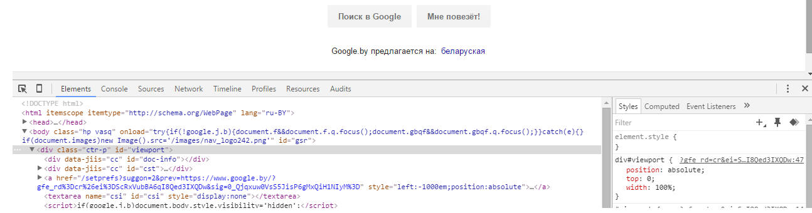
HOW CAN WE SEE THE PAGE DOM?
Using DevTools - web analyzing and debugging tools that are built into browser.
Here is how
chrome DevTools look

Slide 29
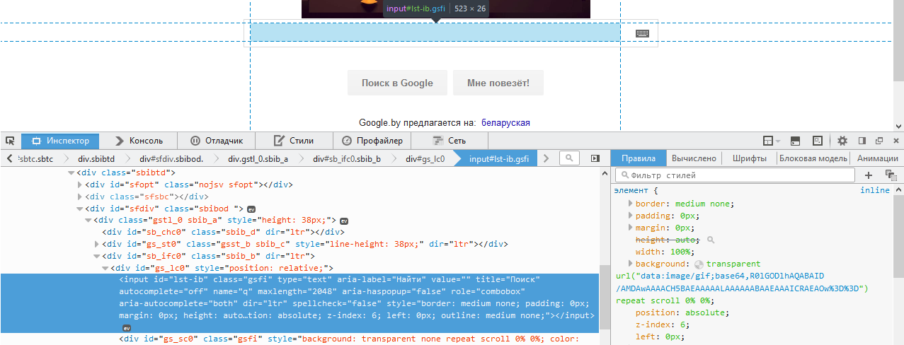
HOW CAN WE SEE THE PAGE DOM?
Here is how
FireFox DevTools look

Slide 30
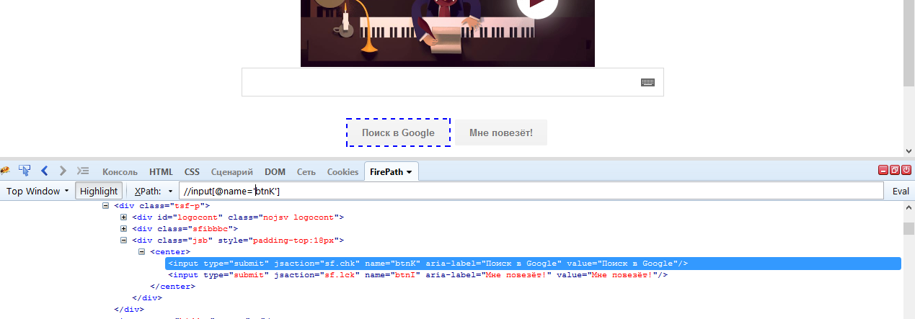
HOW CAN WE SEARCH ELEMENTS USING LOCATORS?
Here is how
FirePath looks

Slide 31
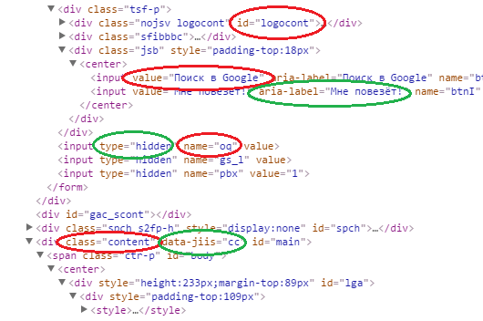
HOW DOES WEBDRIVER LOCATE
WEB ELEMENTS IN DOM?
It can find elements by:
Id
Name
Class
Value
XPath
CSS Selector
other ways

Slide 32
LOCATOR STRATEGIES
Strategy | HTML | Selenium Locator
Identifier | <form id="login"> <input name="username" type="text"/> </form> | identifier=login identifier=username
ID | <form id="login"> | id=login
Name | <input name="username" type="text"/> | name=username
Xpath | <form id="login"> | xpath=//form[@id=‘login’]
Link Text | <a href=“cancel.html”>Cancel</a> | link=Cancel
DOM | <form id="login"> | dom=document.forms[‘loginForm’]
CSS | <form id="login"> | Css=form#login
Tag Name | <form id="login"> | tagName=form

Slide 33
TERMS
XPath is ...
a syntax
a pattern
a language
... for defining parts of an XML document.

Slide 34
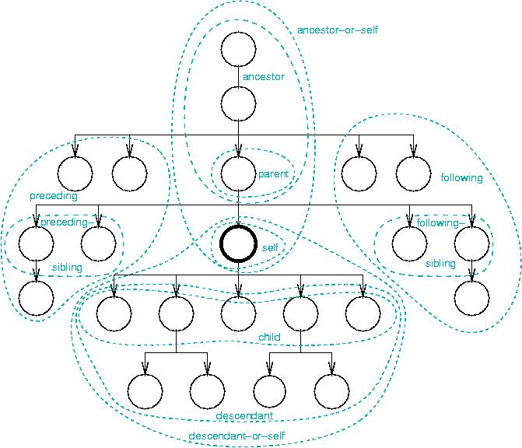
Notes:
Оси Xpath

Slide 35
XPath AXES
AxisName | Result
ancestor:: | Selects all ancestors (parent, grandparent, etc.) of the current node
ancestor-or-self:: | Selects all ancestors (parent, grandparent, etc.) of the current node and the current node itself
attribute:: | Selects all attributes of the current node
child:: | Selects all children of the current node
descendant:: | Selects all descendants (children, grandchildren, etc.) of the current node
descendant-or-self:: | Selects all descendants (children, grandchildren, etc.) of the current node and the current node itself
following:: | Selects everything in the document after the closing tag of the current node
following-sibling:: | Selects all siblings after the current node
namespace:: | Selects all namespace nodes of the current node
parent:: | Selects the parent of the current node
preceding:: | Selects all nodes that appear before the current node in the document, except ancestors
preceding-sibling:: | Selects all siblings before the current node
self:: | Selects the current node

Slide 36
XPATH AXES SHORT SYNTAX
attribute::
child::
descendant::
parent::
self::
@
(becomes /)
/ (becomes //)
..
.

Slide 37
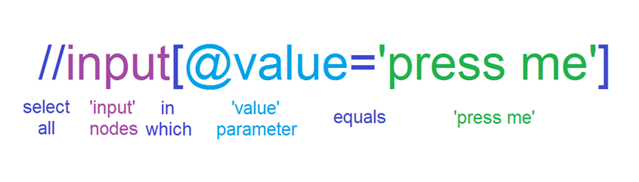
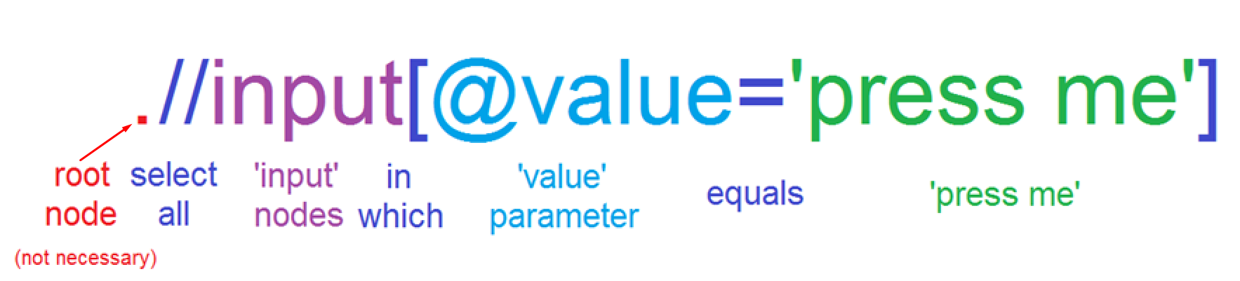
“TRADITIONAL” XPATH LOCATOR

Slide 38
XPATH OPERATORS
Operator | Description | Example
| | Computes two node-sets | //book | //cd
+ | Addition | 6 + 4
- | Subtraction | 6 - 4
* | Multiplication | 6 * 4
div | Division | 8 div 4
= | Equal | price=9.80
!= | Not equal | price!=9.80
< | Less than | price<9.80
<= | Less than or equal to | price<=9.80
> | Greater than | price>9.80
>= | Greater than or equal to | price>=9.80
or | or | price=9.80 or price=9.70
and | and | price>9.00 and price<9.90
mod | Modulus (division remainder) | 5 mod 2

Slide 39
XPATH EXAMPLE – SOURCE XML
<?xml version="1.0" encoding="UTF-8"?> <bookstore> <book> <title lang="en">Harry Potter</title> <price>29.99</price> </book> <book> <title lang="en">Learning XML</title> <price>39.95</price> </book> </bookstore>

Slide 40
XPATH EXAMPLE – PREDICATES
Path Expression | Result
/bookstore/book[1] | Selects the first book element that is the child of the bookstore element
/bookstore/book[last()] | Selects the last book element that is the child of the bookstore element
/bookstore/book[last()-1] | Selects the last but one book element that is the child of the bookstore element
/bookstore/book[position()<3] | Selects the first two book elements that are children of the bookstore element
//title[@lang] | Selects all the title elements that have an attribute named lang
//title[@lang='en'] | Selects all the title elements that have a "lang" attribute with a value of "en"
/bookstore/book[price>35.00] | Selects all the book elements of the bookstore element that have a price element with a value greater than 35.00
/bookstore/book[price>35.00]/title | Selects all the title elements of the book elements of the bookstore element that have a price element with a value greater than 35.00

Slide 41
MORE REALISTIC XPATH LOCATORS EXAMPLES
//button[@id=’submit’]
//div[not(@style=’display:none’)]/a
//*[text()='the visible text' and @class = ‘class1’]
//li[contains(@value, ’choice1’)]
//span[count(div)>=3]
//*[@class='search-result'])/descendant-or-self::*[@id=’banana’]
//a[ends-with(@href, ’.pdf’)]

Slide 42
XPATH - USEFUL LINKS
XPath syntax
XPath axes
XPath operators
XPath functions

Slide 43
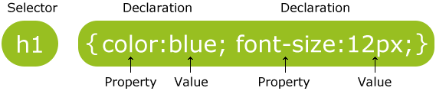
CSS SELECTORS
CSS Selectors work almost the same way, but use style attributes of elements.
They have more specific function and different syntax.

Slide 44
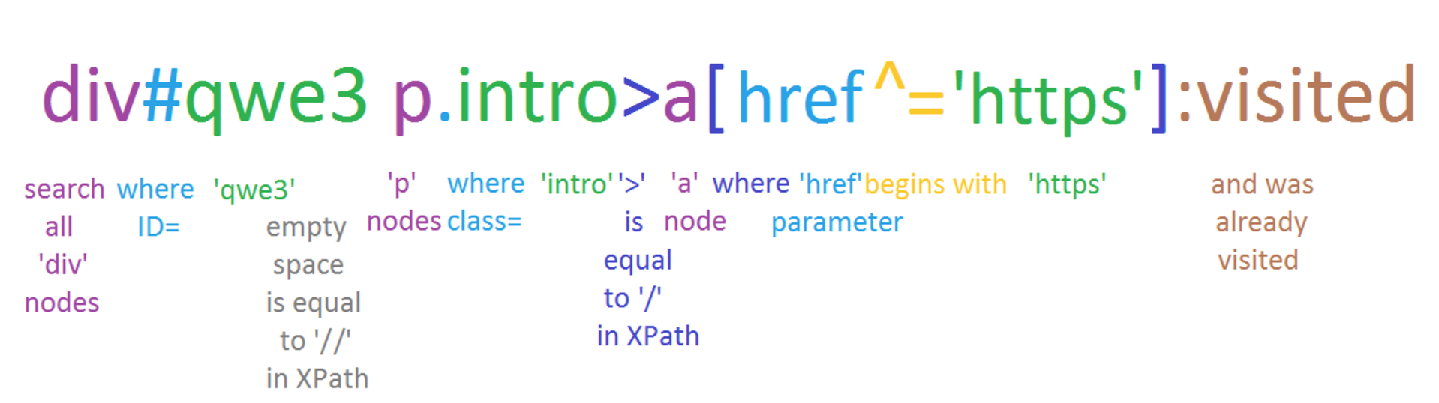
CSS SELECTOR - HOW DOES IT LOOK?
it is pretty hard example :)

Slide 45
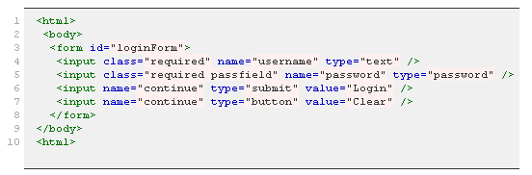
CSS SELECTOR EXAMPLES
form#loginForm (line number 3)
input[name="username"] (line number 4)
input.required[type="text"] (line number 4)
input.passfield (line number 5)
#loginForm input[type="button"] (line number 7)
#loginForm input:nth-child(2) (line number 5)

Slide 46
CSS SELECTOR EXAMPLES
h1
div.tagline
li#intro a
div.result > a
li ~ ul
a[href$=".pdf"]
span.alpha div#id > a:visited

Slide 47
CSS SELECTORS - USEFUL LINKS
CSS Selectors syntax
CSS Selectors examples
CSS Selectors online tester

Slide 48
XPATH - CSS SELECTORS INTERCHANGEABILITY
div.ch #pnnext>span:nth-child(3)
//div[@class=‘ch’]//*[@id=‘pnnext’]/span[3]

Slide 49
WHAT IS BETTER TO USE IN TEST AUTOMATION?
XPath
the most frequently used
easier to use, read and understand
more powerful
can walk on DOM in any directions
has functions and operators
CSS Selector
works faster
looks laconic
has some unique features (like :visited)
harder to use, read and understand
can walk on DOM only down direction
can not search by text
But it is better to know the both :)

Slide 50
LOCATORS: FREQUENTLY MADE MISTAKES
using absolute, generated or too long path
using non-static properties
creating locators that return non-definite results
ignoring the frames
using difficult dependencies when simple location (id) could be used
being sure that locator will never change
//span[@id=’tsf’]/div[2]/div[3]/center/input[2]
//th[@class=’jfk-bubble chw-oc stv-enabled’]
//a[contains(text(),’hello’)]
//input[@id=’pass_input’]
//th[contains(@class, ‘jfk-bubble’)]
//popup[@id=’first_run_popup’]/a

Slide 51
Thanks for attention

